Slide 1

OctaveMandolins
WordPress Demo

Slide 2
Group Members
Adam Metz
Shema Dabiri
Julian Gonzales
Mackenzie Kot

Slide 3
Envisioned Problem/Opportunity
Problem:
Distribution of music sheets
Lack of website functionality
Frustration of current actions
Opportunity:
Enhance user experience
Build and grow design experience
Satisfy customer needs

Slide 4
Northstar and Carryover Customer
Northstar customer
Members of the RMO that seek a simple and easier to use website for their groups needs.
Carryover customers
The rest of the RMO members that may be more technologically proficient, but will still benefit from the improved website, with a better user experience.

Slide 5
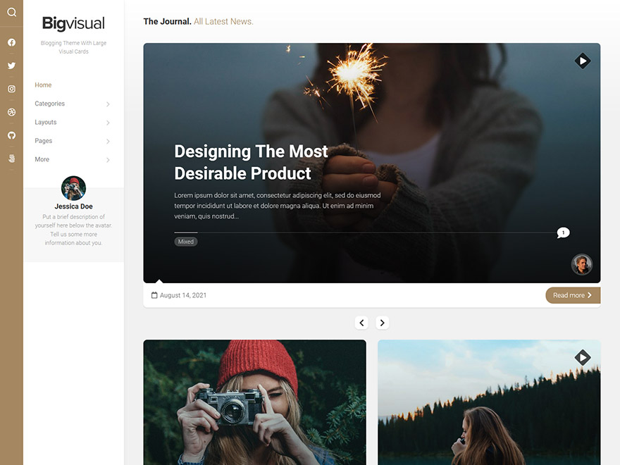
WordPress Theme
Bigvisual Theme
Large simple elements
Simple navbar that stands out
Looks great on mobile, tablet, and desktop

Slide 6
WordPress Plugins
WP Docs - used to display documents on the archives and governance pages
WP Responsive Tabs - used alongside WP Docs to make tabs on the archive page
The Events Calendar - used in place of a google calendar
Event Tickets and Registration - used with the calendar to say if a person is attending the event
Ultimate Member - used for custom roles on the website, the member directory, and account settings
User Role Editor - used to assign multiple roles to a user
Menu Image - used to add icons to the navigation menu
Block Visibility - used to change visibility options of a block based on roles
User Private Files - used to share files with other users on the frontend

Slide 7
WordPress Demo

Slide 8
Image Refs
Bigvisual, https://alx.media/wp-content/uploads/2021/09/screenshot-bigvisual-2.jpg

